Slide 1
How Math is used in computational Programs
Felix Alcantara

Slide 2
When we learn math, we often ask ourselves…
Why do I need to learn this?
Where would I see the use of it?
What can I do with it?

Slide 3
“I like Computer Science, but I HATE Math”

Slide 4
Reasons for students to “hate” Mathematics
“I was never good at Math”
Lack of motivation from the Teachers/Professors
Process of “memorizing”, rather than analyzing.
How Math is applied on different job markets
Computer Science
Engineering
Business

Slide 5
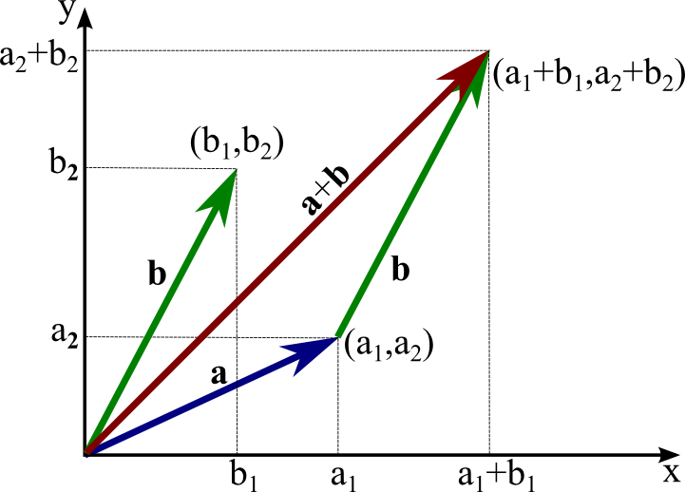
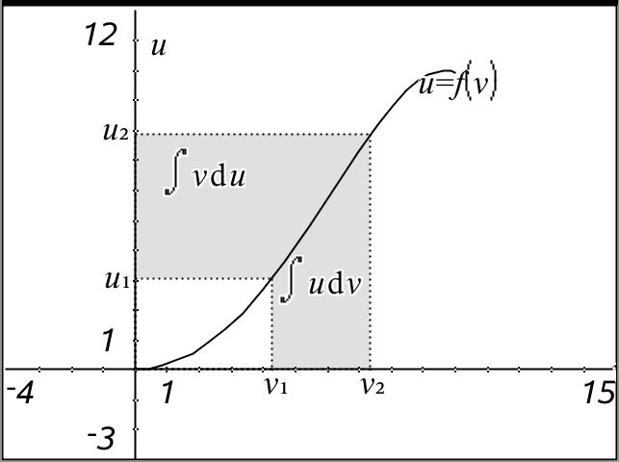
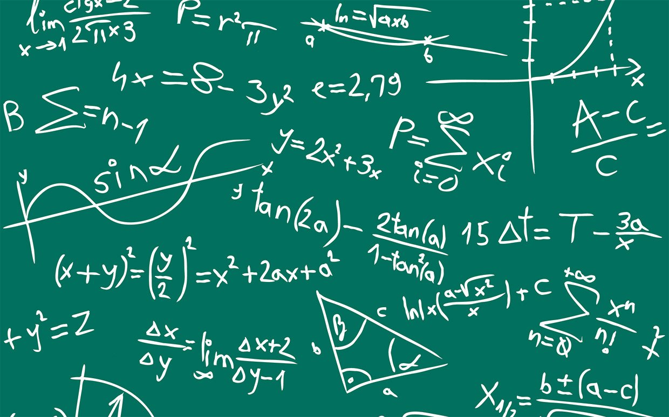
BUT…there is a meaning to all of these
This Photo by Unknown Author is licensed under CC BY-SA

Slide 6
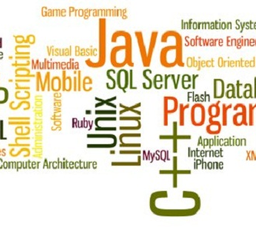
Computer Science
The Study of computers and computational programs
Some of these Computational Programs:
Java
Matlab
C++
Python

Slide 7
Mathematics in the Computational Systems
Math needed for computational systems from the user
How Math is used in computational systems

Slide 8
Math in Computational Programs
Computers Programs are useful:
No more Calculations by hand/multiple calculations
Faster
Efficiently
Computers never get tired
Store larger amounts of information(data)

Slide 9
How is this possible?
It was the user, who had to learn first
We needed to save time in larger calculations
The more the user learns, the faster to implement in computers
Calculations
Plotting
Data analysis

Slide 10
The most Used Math Subjects in C.S.
Discrete Mathematics
Linear Algebra
Probability/Statistics

Slide 11
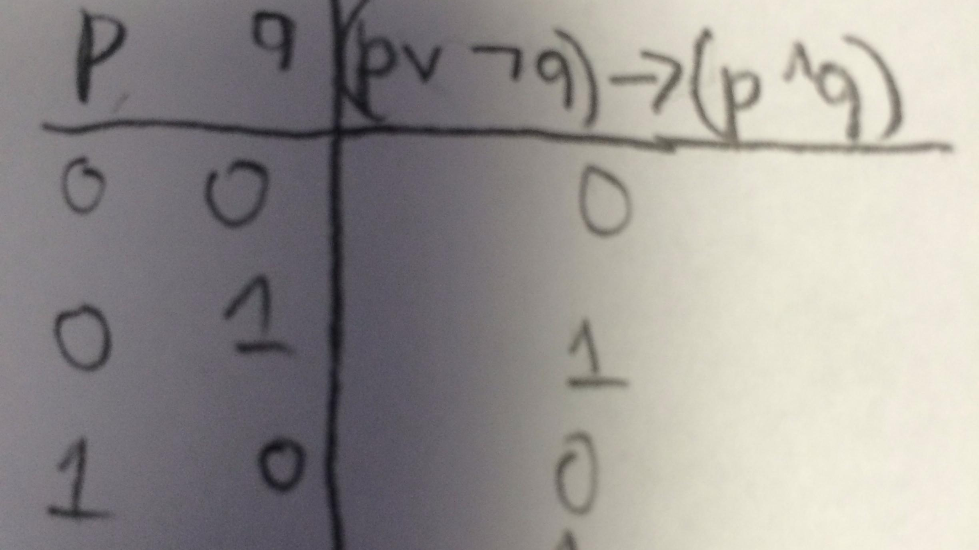
Discrete Mathematics
Describes a set of branches of Math that are “discrete”, rather than “continuous”
From calculation to explanation
Logical thinking
Relational thinking
Recursive thinking
This Photo by Unknown Author is licensed under CC BY-SA

Slide 12
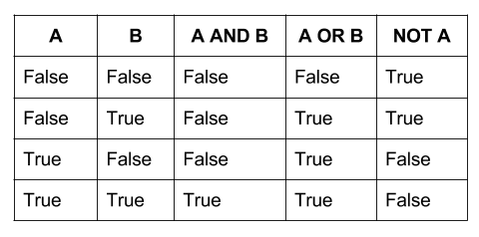
Discrete Math: Logical Thinking
Truth Tables (and, or, and not)
A and B are statements (sentences)
And = ^
Or = ᵛ
Not = ~

Slide 13
Truth Tables Con.:
Truth tables for “If…, then” and “if and only if”
A | B | A → B | A↔B
T | T | T | T
T | F | F | F
F | T | T | F
F | F | T | T

Slide 14
Examples
Let
A = “7 is odd”
B = 7 < 9
What is A ᵛ B?
A →B?
~A?

Slide 15
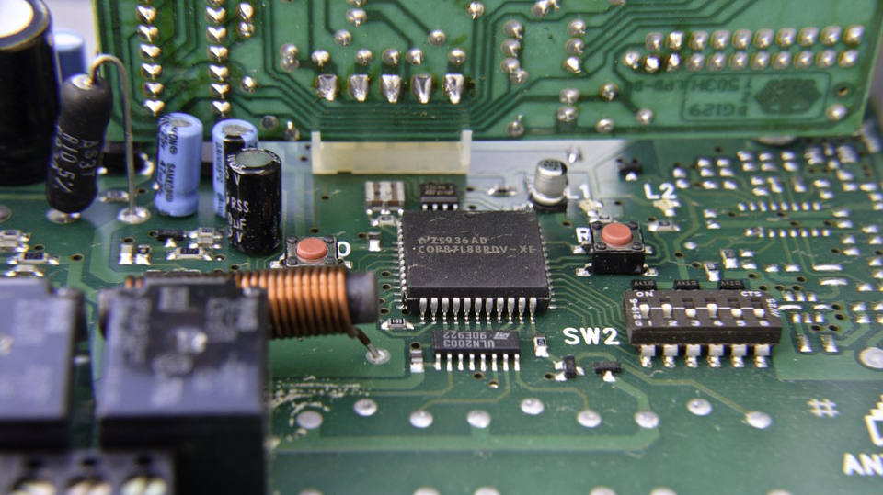
Relational Thinking:
Elements of a set can be related
To each other
To another set

Slide 16
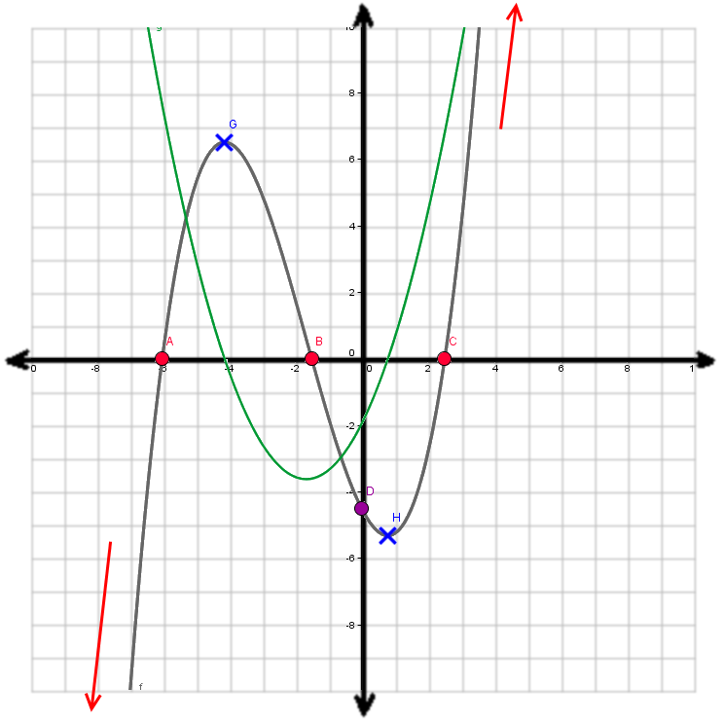
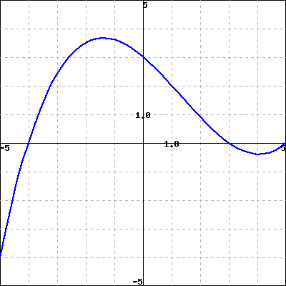
Graphs
Not This type of graphs (at least not for now)

Slide 17
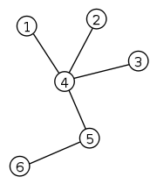
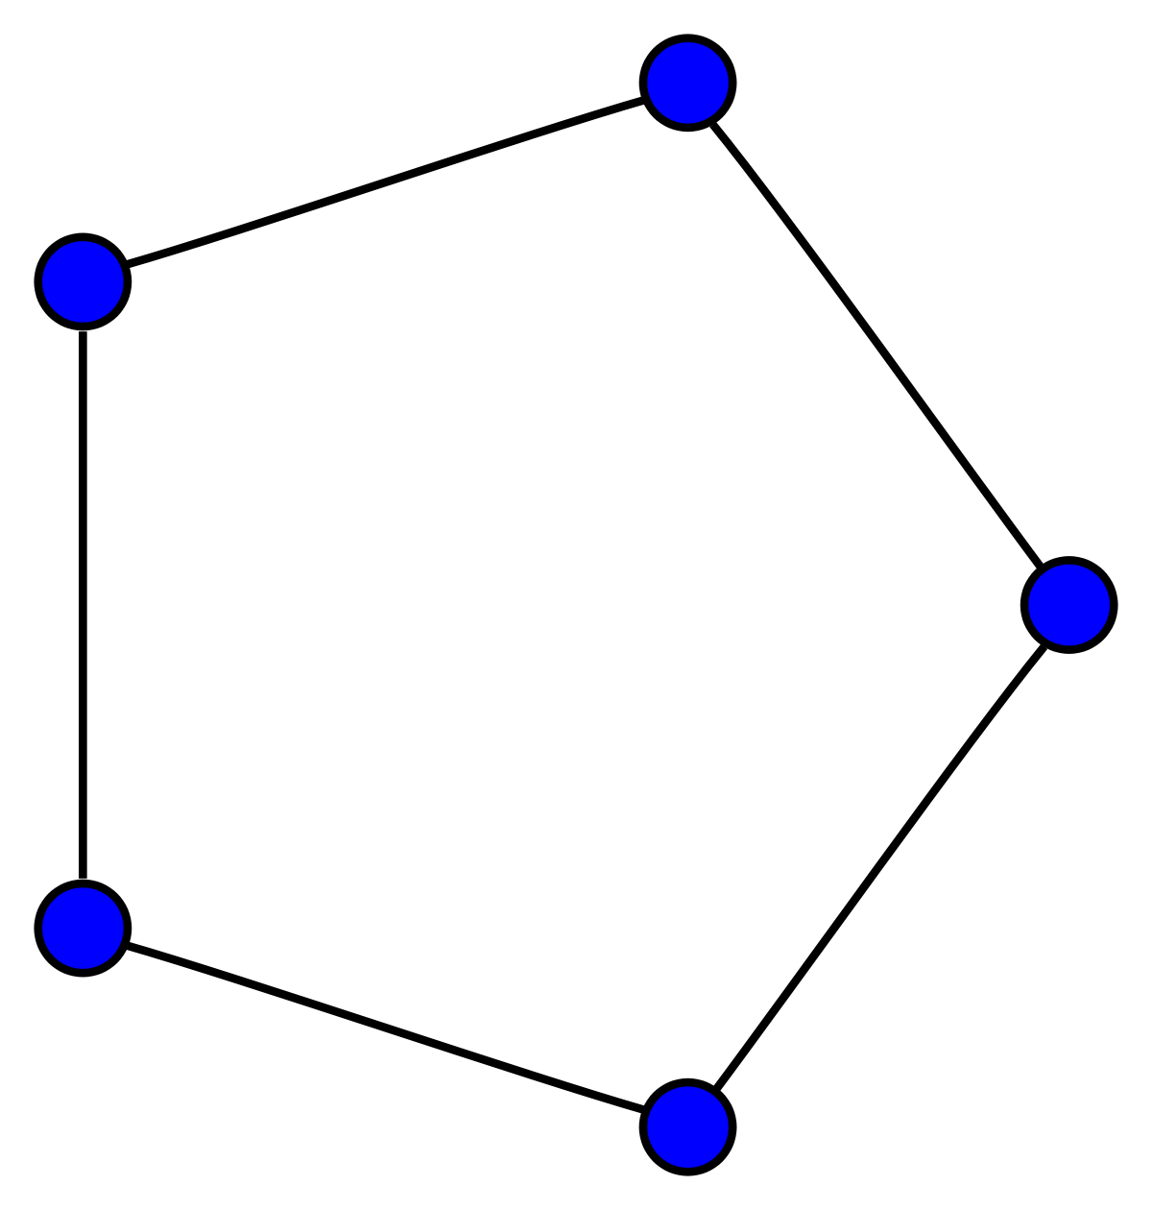
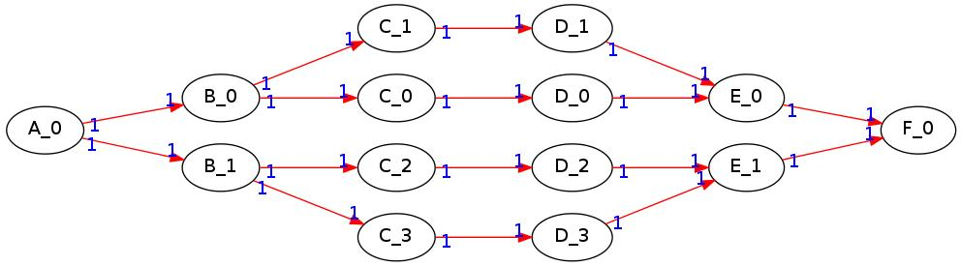
Graph Theory
Edges and vertices (In graphs and Trees)
Allows us to create a relation
Useful for modeling relationships

Slide 18
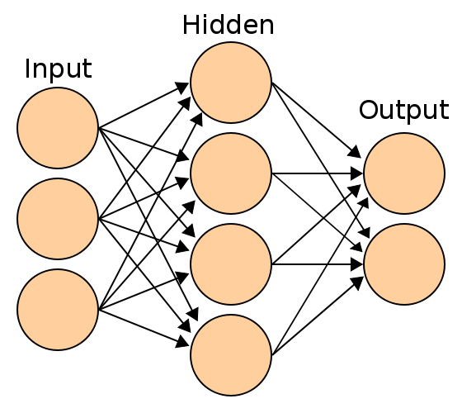
Graph Theory Cont.:
As a computer scientist/engineer, it is important to:
Make a connection with an specific type of data
Being able to find the best pattern to a certain relation
Graph theory is very helpful in areas Such as Deep Learning, and Neural Networks.
This Photo by Unknown Author is licensed under CC BY-SA

Slide 19
Recursive Thinking:
Recursive Structures
Mathematical Induction
Base case
Inductive Hypothesis
Inductive Step

Slide 20
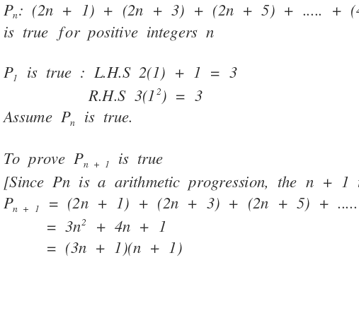
Recursive Thinking:

Slide 21
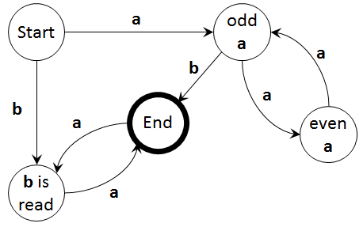
Summary of Discrete Math
Contains main components for a code
The user must understand the logics
Think outside the box

Slide 22
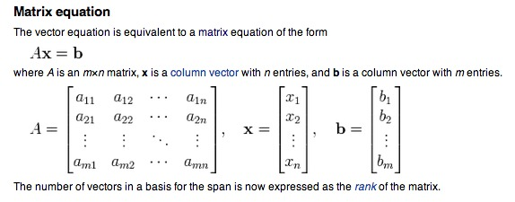
Linear Algebra
The study of sets of linear equations
Matrix computation
Vectors

Slide 23
Matrices are very important
It could represent
Set of data
Images
Graphs (adjacency and incident matrix)

Slide 24
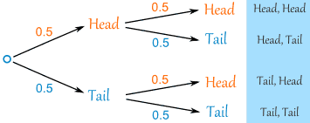
Probability
Study of the odds that an event will occur
Best-worst scenario
Will guide to best solution

Slide 25
Statistics
Solid understanding of probability
Mean, median, variance, and standard deviation
Probability Density Function (pdf)
Normal Distribution
Hypothesis testing
P-values
Confidence intervals

Slide 26
As you progress
Multiple subjects at once
Complex concepts where all are required
Regression
Machine Learning
Image processing (face recognition)

Slide 27
Few applications
Using Matlab
Actual data
The importance of mathematics
The final outcome

Slide 28
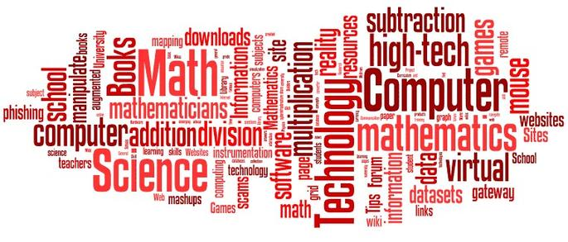
Thank you.

